Slide 1
LIN MODULE INTRODUCTION (local interconnect network)
CUONG.LE – NXA14429
MCAL Team
04/03/2018

Slide 3
Purpose& Object
Overview
Introduce of Protocol
Hardware Support for LIN
Introduce of AUTOSAR LIN Driver
Tips& Tricks
Questions

Slide 4

1
LIN Protocol
3
Driver Development
4
Tips, Trick
2
Structure of Hardware Support
5
Reference documents

Slide 5

MCAL Members
UML design
C, Assemble languages
EUnit, BEART
Autosar,
Non-Autosar
Coding convention (Misra, Compiler warning)
ARM, PPC structures
…

Slide 6
Purpose& Object
Overview
Introduce of Protocol
Hardware Support for LIN
Introduce of AUTOSAR LIN Driver
Tips& Tricks
Questions

Slide 7
2.1 History
Electronic systems in modern cars use expensive communications: CAN, FlexRay, SPI, Ethernet& IP…
Increasing number of ECUs (Electronic Control Unit)
High production costs
Need a cheaper communication
Notes:
Because of increasing number of ECUs (Electronic Control Unit) in electronic systems, so we need a cheaper communication which use of low speed connection

Slide 8








2.1 History (Continues)
Version | Publication date
LIN 1.0 | 01-07-1999
LIN 1.1 | 06-03-2000
LIN 1.2 | 17-11-2000
LIN 1.3 | 13-12-2002
LIN 2.0 | 16-09-2003
LIN 2.1 | 24-11-2006 (Applies for MCAL)
LIN 2.2A | 31-12-2010 (Applies for SDK)
ISO17987 | In progress
Notes:
End of 1999, 5 automakers and 2 semiconductor manufacturers inventted LIN (Local Interconnect Network) with properties: Simple, economical and standard use for sensors and actuators

Slide 9
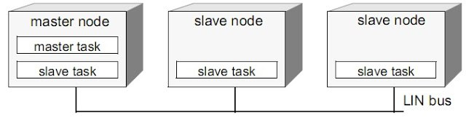
2.2 Concepts
LIN is a serial network protocol used for communication between components in vehicles
Network topology is a BUS model
Broadcast serial network comprising 16 nodes (1 master and typically up to 15 slaves)

Slide 10
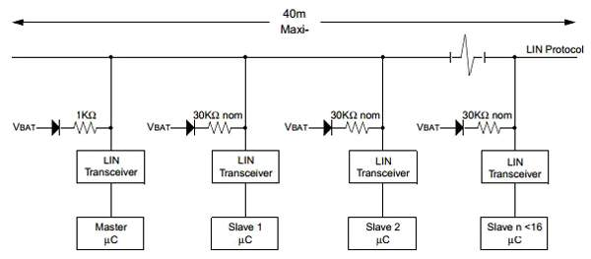
2.3 Features and parameters
Single wire communications with 40 meters bus length
Multi-cast reception with time synchronization, without crystals or ceramic resonators
Operating voltage: 9 - 18V (Default: 12V)
Baudrate: 1 - 20 Kbit/s (limited by EMI)
Hardware support:
UART/ SCI/ ESCI/ GPIO/ FLEXIO/ LINLFEX
Notes:
EMI:

Slide 11
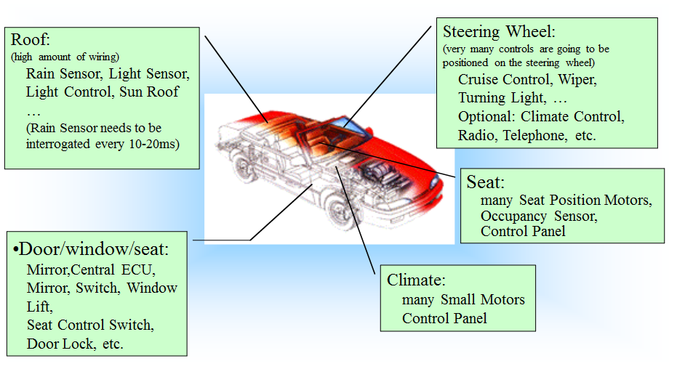
2.4 Applications

Slide 12
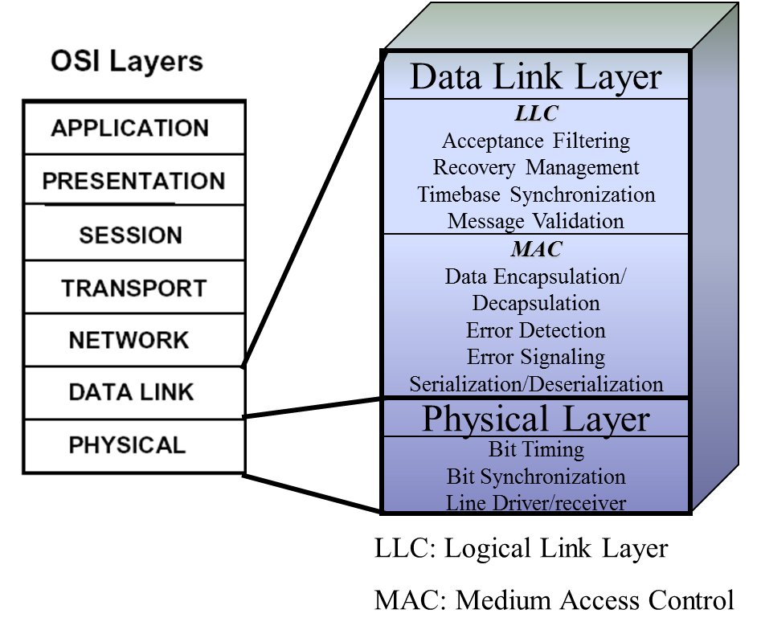
2.5 The 7 Layers of the OSI Model
Physical: What is the hardware structure and type of signal on the bus?
Data link: How does the LIN model work?

Slide 13
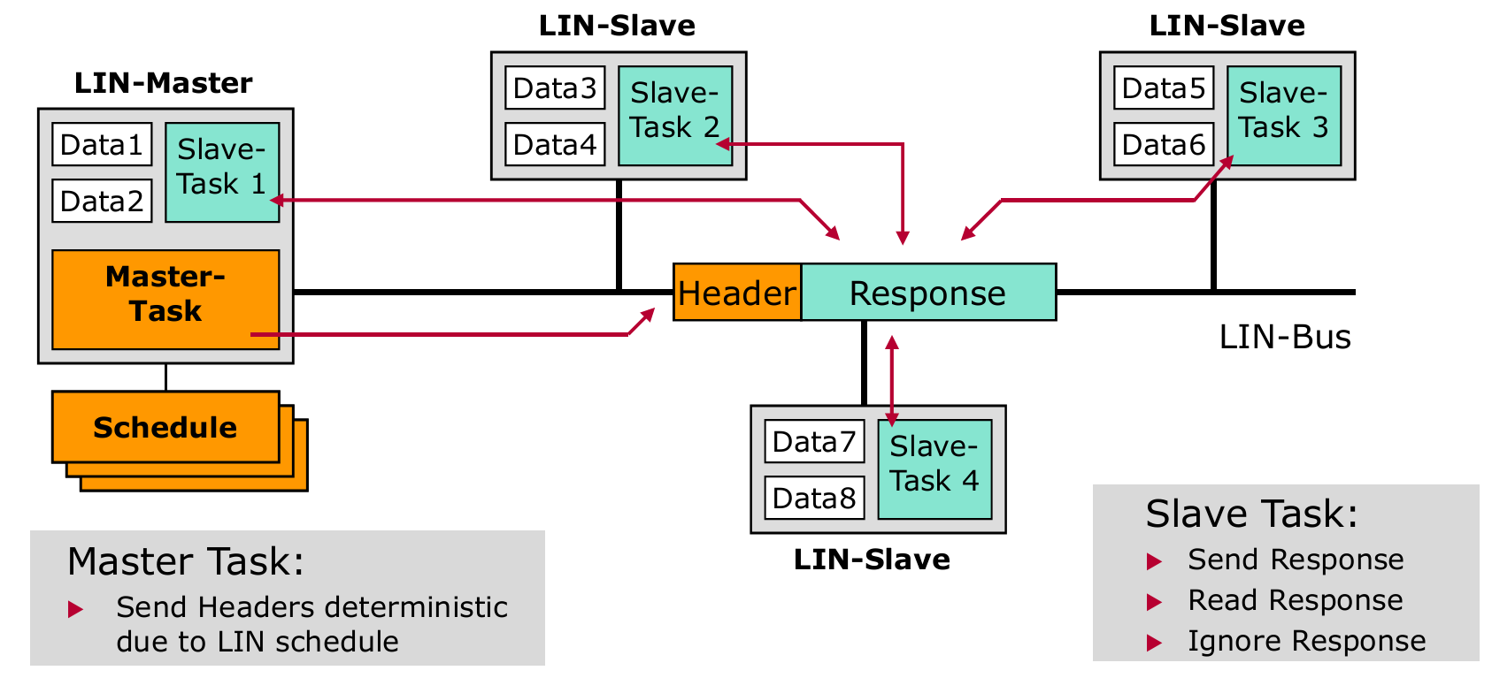
2.6 Operation of LIN
1 master node, typically up to 15 slave nodes
Master node decides the rules of LIN's network operation through the Token principle (the PID field in the header)
The scope of the driver
Notes:
For LIN, nodes do not have equal roles because of Master-Slave architecture.
Frame format has 2 parts is:
Header (included: initialization information, synchronous baudrate and frame type)
Response (included: data, checksum)

Slide 14
2.6 Operation of LIN (Continues)
Master Task: Master node
Determine the order and priority of the message
Control of the network activity by sending the Header
Receive wake up signals from slave nodes
Set network to sleep mode
Slave Task: Master, Slave nodes
Detect break field of header
Based on the PID of the header to respond compatible
Master Node
identifier
synch field
synch break
Slave Node
LIN Master Task
Slave Task Rec
quartz
Slave Task Trans
Slave Task Rec
data byte
data byte
checksum
Slave Task Trans

Slide 15
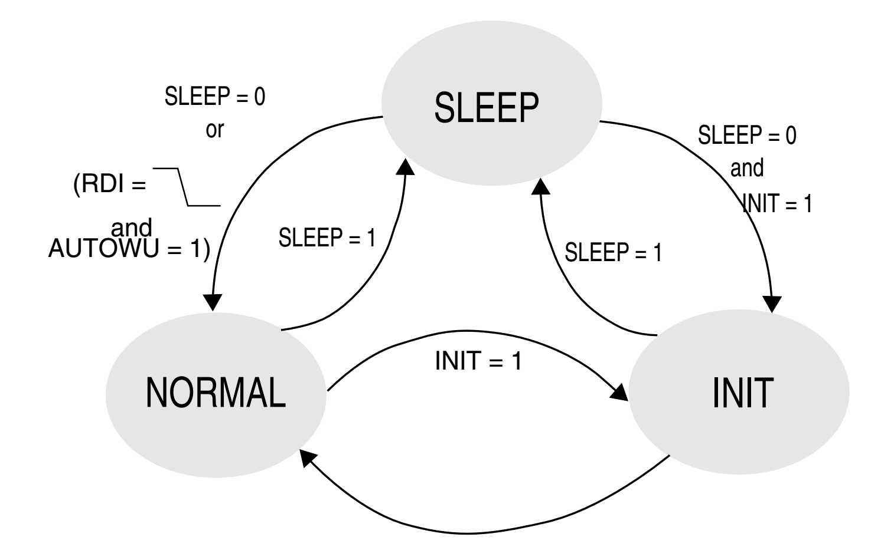
2.6 Operation of LIN (Continues)
Each node has 3 operation state:
Normal: Transmit/ Receive data
Sleep: Low power mode, limit operation, except transmit and receive wakeup pulse
Init: Config baudrate, operation mode… (<100ms)

Slide 16
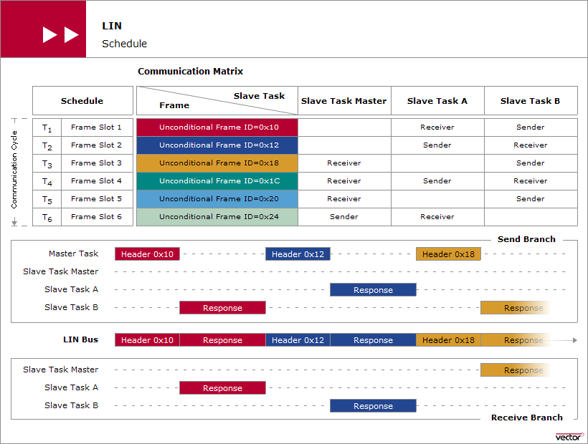
2.6 Operation of LIN (Continues) – NORMAL MODE

Slide 17
2.6 Operation of LIN (Continues) – SLEEP MODE
Node master send Sleep command to Bus:
8 bytes data: 0x00, 0xFF, 0xFF, 0xFF, 0xFF, 0xFF, 0xFF, 0xFF
ID: 0x3C
Bus LIN does not operate transmit / receive within 4-10s, the node automatically Sleep

Slide 18
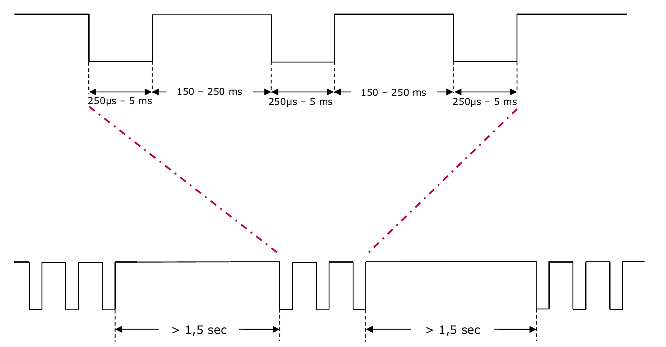
2.6 Operation of LIN (Continues) – WAKEUP MODE
Any node can send a wakeup pulse: dominant pulse of 250us to 5ms
Notes:
Is there no way to detect the wakeup nodes?

Slide 19
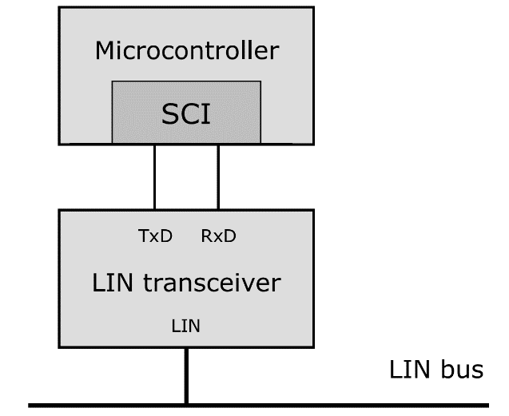
2.7 Hardware, Bus
Node = MCU + Transceiver IC
IC transceiver must satisfy the conditions Transceiver Delay (Part 4)
Notes:
IC Transceiver is responsible for converting two Tx, Rx signals from the MCU (3.3, 5V) to one single signal and connecting to the BUS.

Slide 20
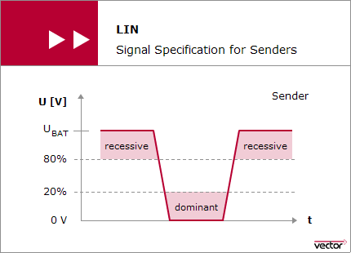
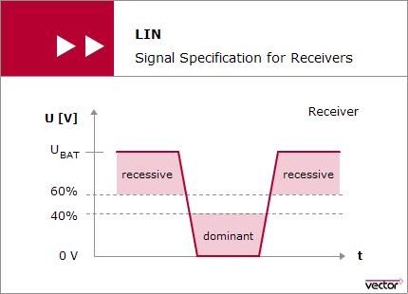
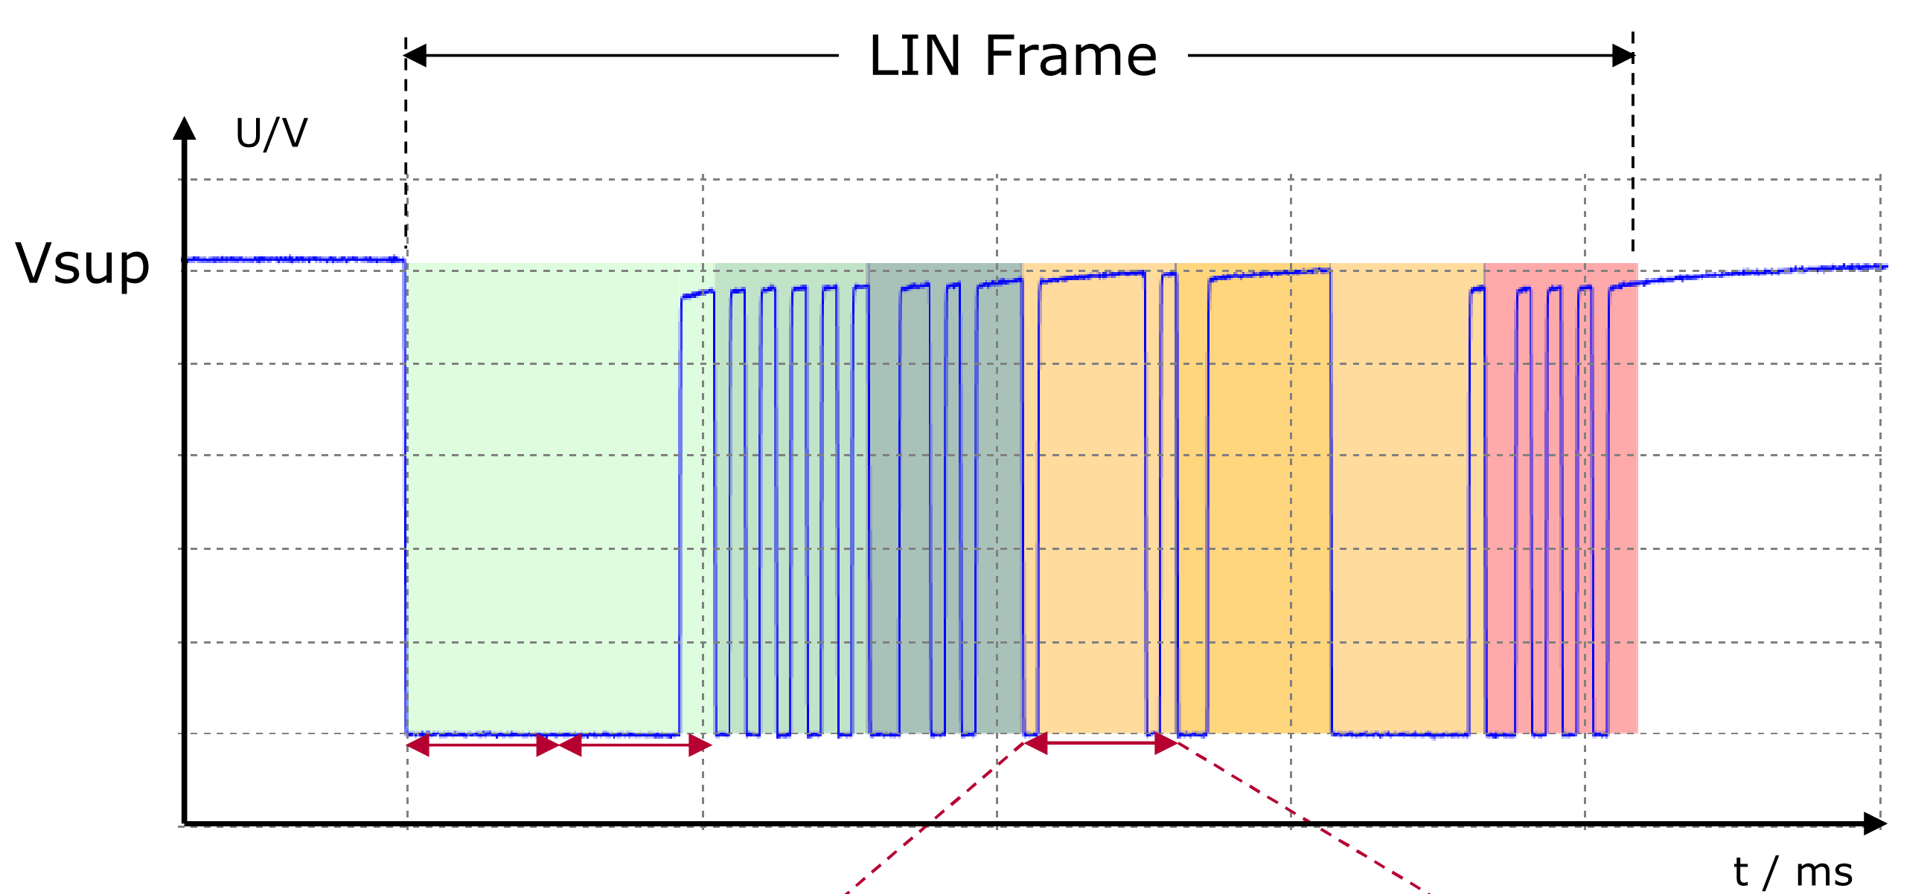
2.7 Hardware, Bus
The level of inactivity: 1 (12V)
Differential levels 1 and 0 vary during transmission and reception

Slide 21
2.8 Schedule
Based on the width of the frame
The calculation shown in part 3

Slide 22
Purpose& Object
Overview
Introduce of Protocol
Hardware Support for LIN
Introduce of AUTOSAR LIN Driver
Tips& Tricks
Questions

Slide 23
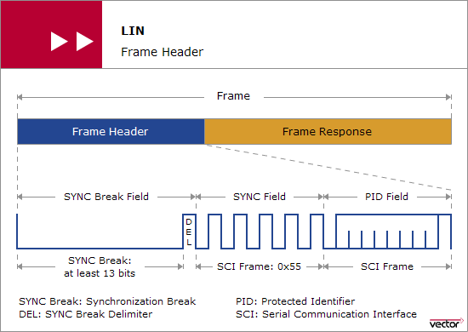
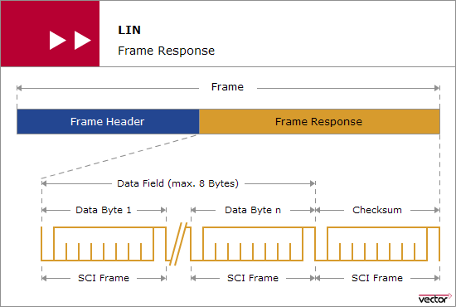
3.1 Frame
Header is sent by Master task (Master node)
Response is sent by Slave task (Master/ Slave node)
LIN communicates by frame

Slide 24
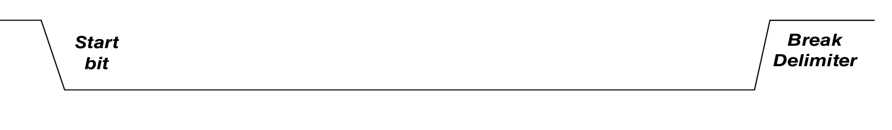
3.2 Header – Break Field
Sync Break: 13 –> 50 bit level 0
Sync Break Delimiter: 1 -> 2 bit level 1
Mission: Start signal of new transmission frame

Slide 25
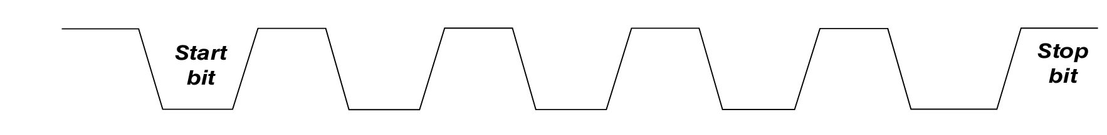
3.2 Header – Sycn Field
Length: 1 byte – value: 0x55
1 bit start (0b)
1 bit stop (1b)
Type of transmission: LSB
Mission: Slave node synchronizes baudrate with master node
Notes:
LSB (Least Significant Bit)

Slide 26
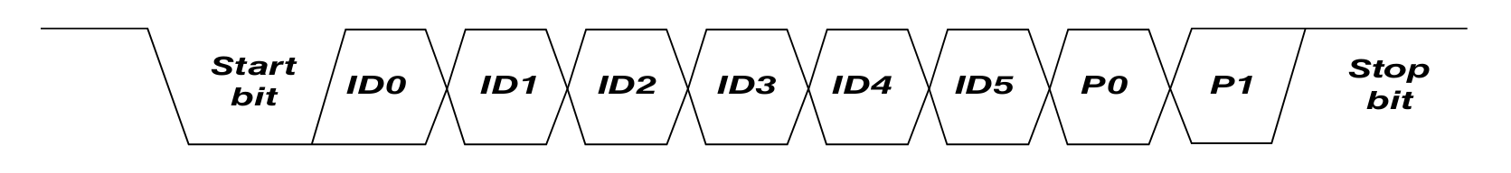
3.2 Header – PID Field
Length: 1 byte
Identifier: 6 bit, ID0 - ID5
Identifier parity: 2 bit, P0 and P1
1 bit start (0b)
1 bit stop (1b)
Type of transmission: LSB
Mission: Specifies the function of the transmission frame
P0 = (ID0 ^ ID1 ^ ID2 ^ ID4)
P1 = ~ (ID1 ^ ID3 ^ ID4 ^ ID5)

Slide 27
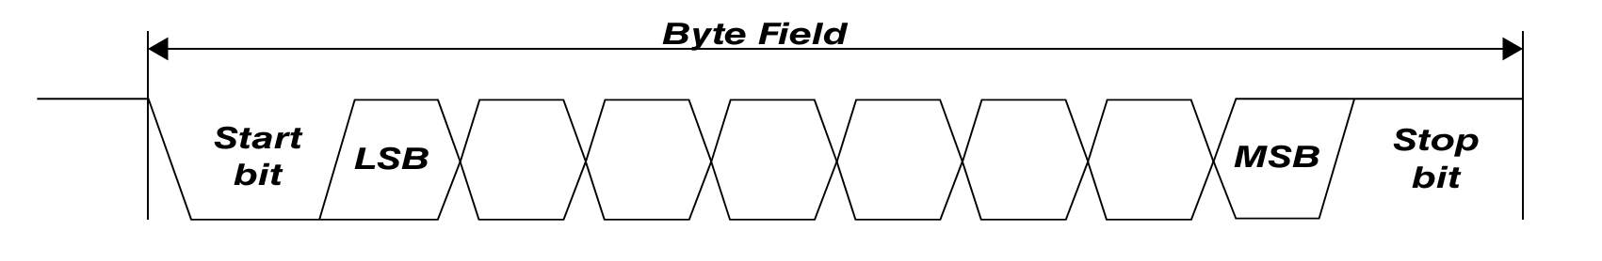
3.3 Response – Data field
Length: 1 – 8 bytes data
1 bit start (0b)
1 bit stop (1b)
Type of transmission: LSB
Mission: data exchange

Slide 28
3.3 Response – Checksum Field
Length: 1 byte
1 bit start (0b)
1 bit stop (1b)
Type of transmission: LSB
Mission: Verify the accuracy of the data

Slide 29
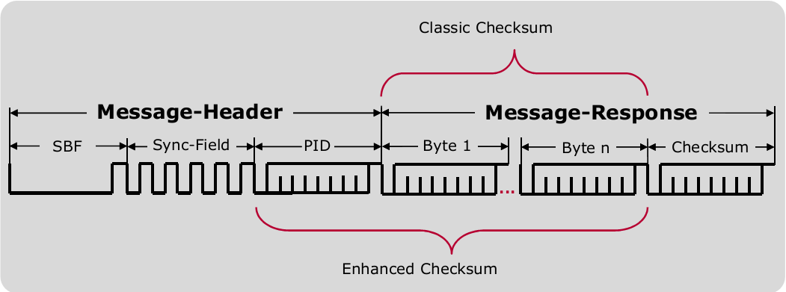
3.3 Response – Checksum Field
Classic Checksum: LIN 1.1, LIN 1.2 and LIN 1.3:
Checksum = INV (data byte 1 ⊕ data byte 2 ⊕ ... ⊕ data byte 8)
Enhanced Checksum: LIN 2.0, LIN 2.1 and LIN 2.2:
Checksum = INV (data byte 1 ⊕ data byte 2 ⊕ ... ⊕ data byte 8 ⊕ PID)

Slide 30
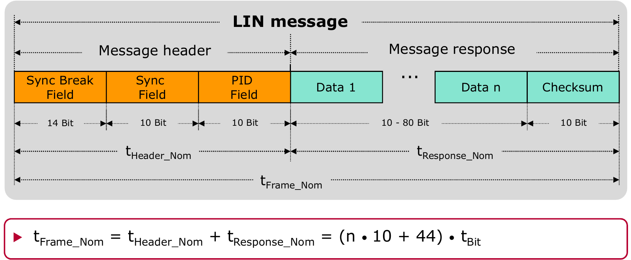
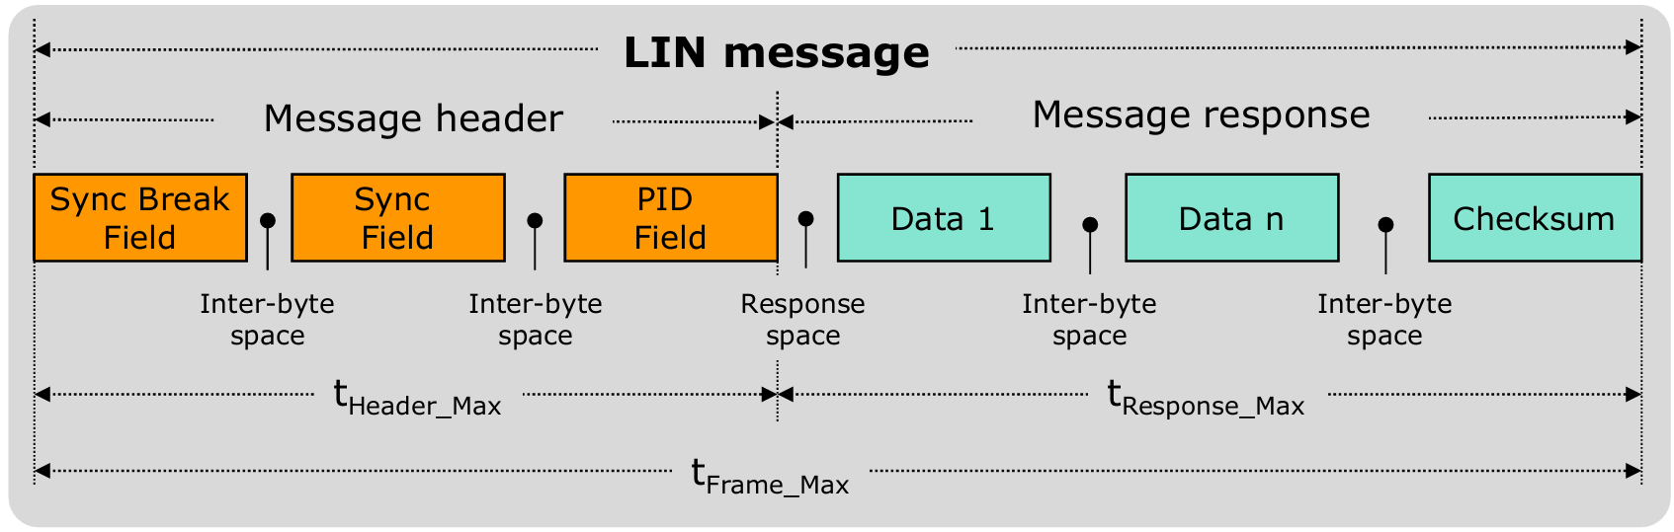
3.4 Frame width
Fixed fields, except for the number of bytes in the data field
Time reserve: 40% frame
The basis for determining whether there is a transmission error?
Customer requests Disble_frame_timeout feature
Notes:
Customers use a Slave node simulator, but the response time of the device is quite slow. Therefore, the client has requested an option to check the frame response time (Disable_Frame_Timeout)

Slide 31
Purpose& Object
Overview
Introduce of Protocol
Hardware Support for LIN
Introduce of AUTOSAR LIN Driver
Tips& Tricks
Questions

Slide 32
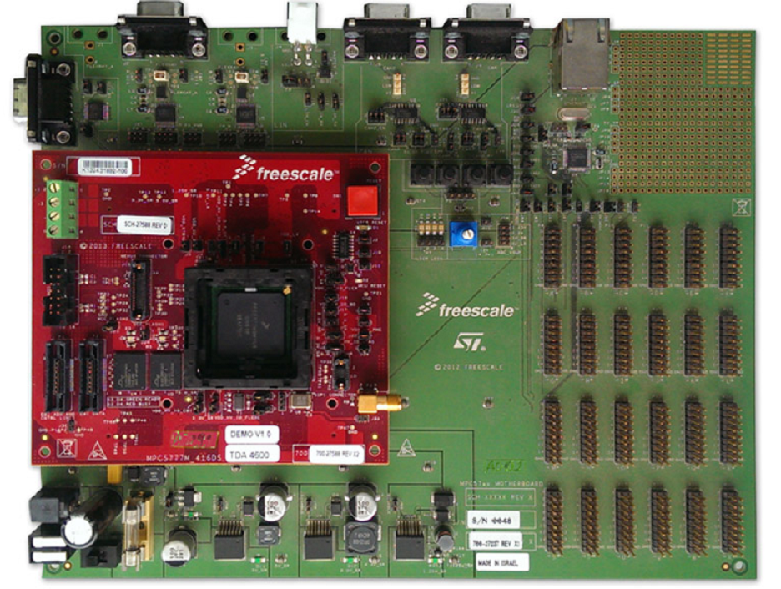
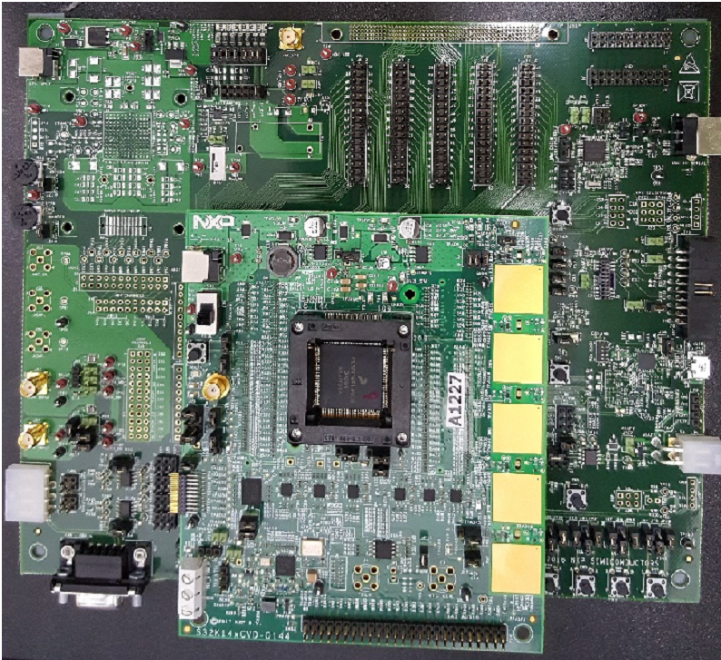
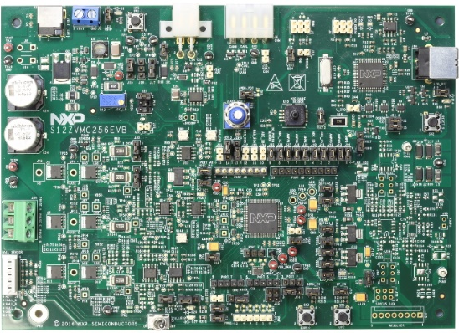
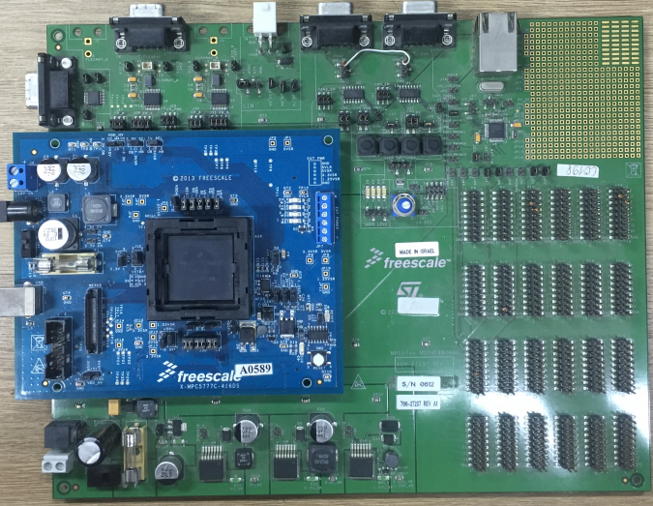
LIN
LINFLEXD
IMXVS4, MPC574XP, MPC574XG, MPC574XR, MAC57DXXX, S32R27X…
LPUART
S32K14X
SCI
MC9S12ZVM, MC9S12ZVC
ESCI
MPC5777C
Notes:
For now, LIN Driver has 4 IPVs (corresponding 4 hardware)

Slide 33
4.1 LINFLEXD – Block diagram
Transmit Control: Controls the data from the buffer to the translation, the transfer request, the configuration mode
Receiver Control: Control takes the data from the register into the buffer, the request to receive the interrupt
Baudrate unit: Set the baudrate of the transmitter frame, powering the timer
Interrupt unit: Create and send interrupts Tx, Rx, Err for MCU
Timer unit: Count frame transmission time
Other unit: Shift Tx, Rx registers; buffer registers, control and status registers
Notes:
Shift Tx, Rx registers; buffer registers, control and status registers

Slide 34
4.1 LINFLEXD – Block diagram
How will the registers work? Refer to part 5
What errors are detected by the hardware?
Discard Frame

Slide 35
4.2 LINFLEXD – Detect bug
(1) Header error: Slave node
SFEF: Delimiter too short, less than 1 bit
SDEF: Sync field is incorrect baurate:
D > 14.0625%
IDPEF: P0, P1 invalid
Note: Out of scope of driver
1
2
3

Slide 36
4.2 LINFLEXD – Detect bug
1
2
3
(2) Bit error: Master node
Flag: LINESR_BEF
Readback mechanism signals from the bus, comparing the Tx and Rx pins
Do not check the Break field
4
5

Slide 37
4.2 LINFLEXD – Detect bug
1
2
3
(2) Bit error: Master node
Note: Delay parameter of IC transceiver must less than:
(1 bit – 6 x LIN_CLK cycle)
Example:
Baudrate = 20 Kbit/s => T_1bit = 50 µs
LIN_CLK = 80 MHz => 6 x LIN_CLK = 75 ns
T_Delay_IC < T_1bit - (6 x LIN_CLK cycle) = 49.925 µs
4
5

Slide 38
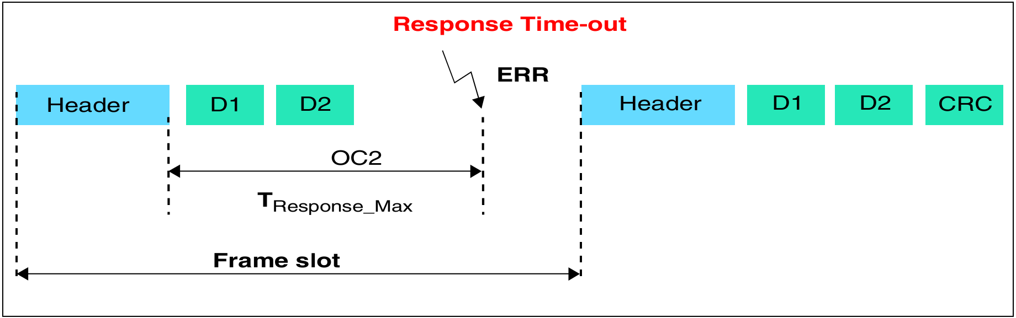
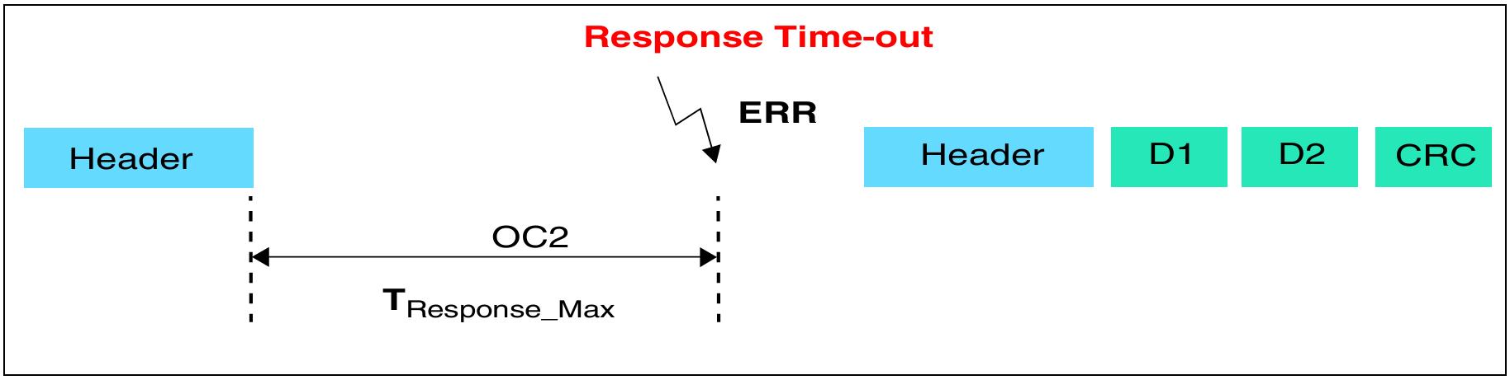
4.2 LINFLEXD – Detect bug
(3) Timeout error: Master, Slave node
Flag: LINESR_OCF
Master: After transmission header, load TIMEOUT VALUE into LINOCR_OC2:
Nominal_time_out + [CNT] = 1.4 × ((DFL + 2) × 10 bit time + [CNT])
Slave: Read chapter 2.3.1 of document, out of scope

Slide 39
4.2 LINFLEXD – Detect bug
1
2
3
(4) Framing error: Master, Slave node
Flag: LINESR_FEF
Value of any stop bits is 0b, instead 1b
4
5

Slide 40
4.2 LINFLEXD – Detect bug
(5) Checksum error: Master, Slave node
Flag: LINESR_CEF
Value of checksum byte does not match received data

Slide 41
4.2 LINFLEXD – Detect bug
(6) Overrun error: Master, Slave node
Flag: LINESR_BOF
Full buffer, due to data was not read
CR1_RBLM = 0: Old data in the buffer was overwritten by the new data
CR1_RBLM = 1: New data is aborted

Slide 42
4.2 LINFLEXD – Detect bug
(7) Stuck at zero timeout error: Master, Slave node
Flag: LINESR_SZF
Dominant pulse lasts for a time of at least 100 bits

Slide 43
4.2 Compare the hardware characteristics
No | Feature | LINFLEXD | ESCI | SCI | LPUART
1 | Break length (bit) | (11 -> 23), 36, 50 | 10, 13 | 10, 13 | 10, 13
2 | Data register (byte) | Sum: 8 LINFlexD_BDRM - 4 LINFlexD_BDRL – 4 | Sum: 8 eSCI_LRR – 1 eSCI_LTR – 1 | Sum: 1 SCIDRL – 1 | Sum: 1 LPUART_DATA – 1
3 | Support DMA | 2/16 channels (LINFlexD[0], LINFlexD[1]) | 2/6 channels (eSCI_A, eSCI_B) | None | 3/3 channels (LPUART0, LPUART1, LPUART2)
4 | Timer | Yes | Yes | None | None
5 | Sleep mode | Yes | Stop mode | None | None
6 | Wakeup flag | Yes | Yes | None | None
7 | Checksum calculate | Yes | Yes | None | None
8 | PID calculate | Yes | Yes | None | None

Slide 44
Purpose& Object
Overview
Introduce of Protocol
Hardware Support for LIN
Introduce of AUTOSAR LIN Driver
Tips& Tricks
Questions

Slide 45
LIN High Level Driver: Autosar function
LIN IP Wrapper: Connect 2 layers HLD and IPVault (hardware platforms)
LIN IP Vault: Implement register level of functions, no Autosar rule
LIN Plugin: Implement the template files, configure the operation parameters

Slide 46
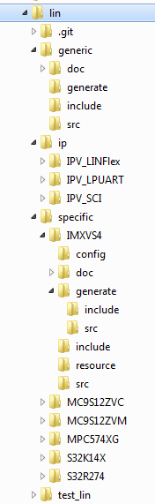
5.1 Folder structure

Slide 47




5.2 Driver build process
1. Scope, milestone
2. Requirement, use case (AUTOSAR)
3. Algorithm diagram
4. Develop driver
5. Test
6. Distribution
1.Analysis
3.Design
4.Implement
2.Requirement
5.Test
6.Distribution

Slide 48
5.2 Driver build process
1. Scope, milestone
Porting
Important

Slide 49
5.2 Driver build process
2. Requirement,
use case (AUTOSAR)

Slide 50
5.2 Driver build process
3. Algorithm diagram
No | Feature | LINFLEXD | ESCI | SCI | LPUART
1 | Support generate and detect Break field | Yes | Yes | Yes | Yes
 | Length of Break field (bit) | 11 -> 23, 36, 50 | 10, 13 | 10, 13 | 10, 13
2 | Data transfer / receiving type | Frame | Frame | Byte | Byte
 | Length of data register (byte) | LINFlexD_BDRM - 4 LINFlexD_BDRL - 4 | eSCI_LRR – 1 eSCI_LTR – 1 | SCI_DRL – 1 | LPUART_DATA - 1
3 | Support DMA (channel) | 2/16 channels (0, 1) | 2/16 channels (A, B) | None | 3/3 channels (0, 1, 2)
 | Already exist in driver | None | Yes | None | None
4 | Disable Frame Timeout feature | Yes | Yes | None | None
 | Timer hardware | Yes | Yes | None | None
5 | Sleep mode | Yes | Yes | None | None
6 | Detect wakeup pulse | Yes | Yes | Yes | Yes
 | Wakeup flag | Yes | Yes | None, use software flag | None, use software flag
7 | Support Checksum calculation | Yes | Yes | None, use software flag | None, use software flag
8 | Support ID Parity (P0, P1) calculation | Yes | Yes | None, use software flag | None, use software flag

Slide 51
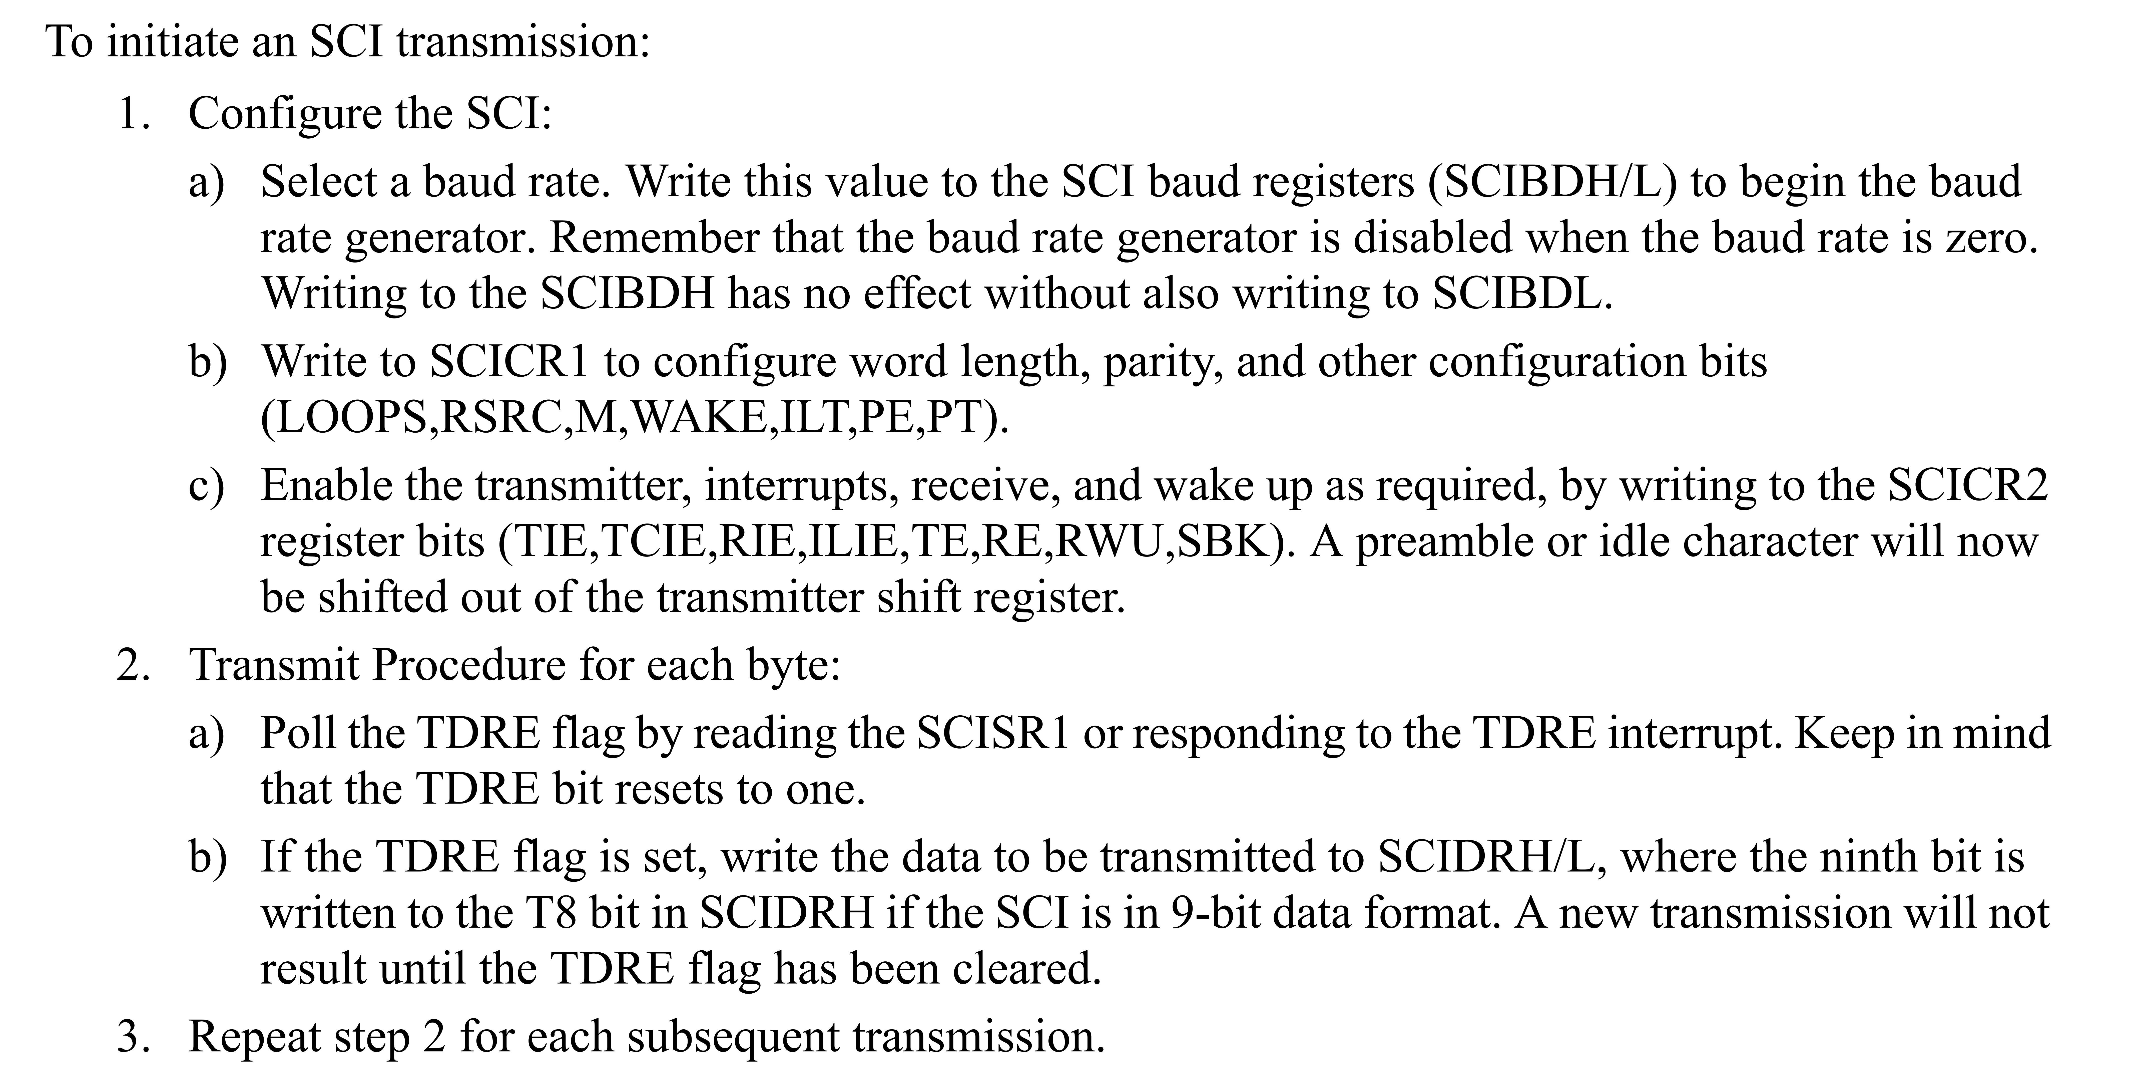
5.2 Driver build process
3. Algorithm diagram - Lin_SCI_InitChannel function
Refer to 16.4 Functional Description in RM (MC9S12ZVM-Family Reference Manual and Datasheet):
Baud Rate Generation
Data Format
LIN Support

Slide 52
5.2 Driver build process
3. Algorithm diagram - Lin_SCI_TxRxInterruptHandler function
Refer to 16.5.3 Interrupt Operation in RM (MC9S12ZVM-Family Reference Manual and Datasheet)

Slide 53
5.2 Driver build process
4. Develop driver
From the algorithmic diagrams that detail the lines of code
Refer to the current IPV for the template function
Notice the rules: Misra, Compiler warning

Slide 54
5.2 Driver build process
5. Test driver
An important step in the process of building a new IPV
Debug generate, build
Debug to check, modify the code flow of the driver (step 3, 4) was correct or not?

Slide 55
5.2 Driver build process
6. Distribution
Process of manage code, task

Slide 56
5.3 EB Configuration

Slide 57
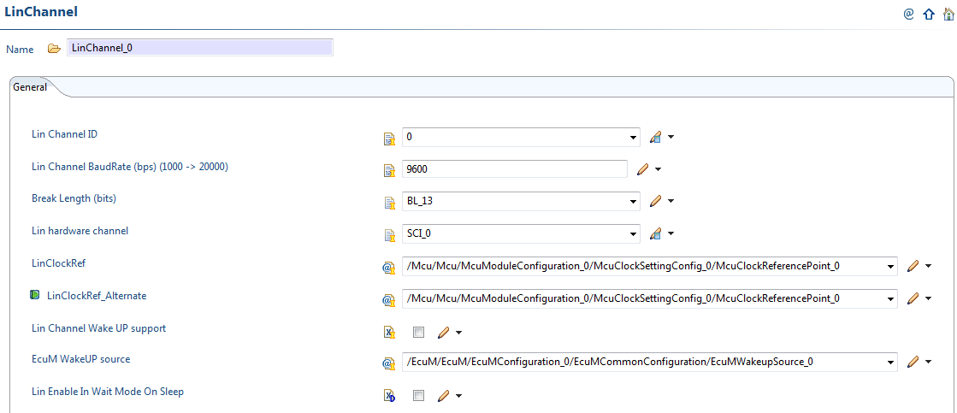
5.3 EB Configuration (Continues)

Slide 58
5.4 Reference document
Content
Where?
2. User manual
AUTOSAR_MCAL_LIN_IM.pdf, AUTOSAR_MCAL_LIN_UM.pdf
3. Algorithm diagram of Driver
UML design (AUTOSAR_MCAL_LIN_SDD.EAP)
4. Features, hardware
Reference Manual
5. LIN protocol
LIN Specification Package Revision 2.1, November 24, 2006
6. Scenario, configure the test suite
LIN_Test_Detail.xlsx
7. Debug experience
Debug_Log.xlsx
8. Summary
Module_Introduction_LIN.docx
1. Requirement
Specification of LIN Driver (AUTOSAR_SWS_LINDriver.pdf)

Slide 59
Purpose& Object
Overview
Introduce of Protocol
Hardware Support for LIN
Introduce of AUTOSAR LIN Driver
Tips& Tricks
Questions

Slide 60
6.1 Circuit diagram
1. Stuck at zero timeout error:
Does power supply for for IC transceiver?
Is the pin Rx connected to the ground?
Notes:
In the case of corrupted IC transceiver happens many times + want to test multiple channels at the same time. So, the Group 1 has designed a mini LIN circuit consisting of three IC transceivers.
- USB: Connect the Lauterbach device from the computer to the board, used to debug and load the code
- RS232: LIN hardware connection with microcontroller, communication command MAF
- Connect LIN: LIN bus, Master connection with one slave or up to 3 slaves

Slide 61
6.1 Circuit diagram
2. Hardfault when acess register:
Clock of the peripheral has not been setting
Notes:
In the case of corrupted IC transceiver happens many times + want to test multiple channels at the same time. So, the Group 1 has designed a mini LIN circuit consisting of three IC transceivers.

Slide 62
6.1 Circuit diagram
3. No signal in BUS:
Is the IC transceiver powered?
Setup interrupt wrong
Configure function for pin or connect wrong
Notes:
In the case of corrupted IC transceiver happens many times + want to test multiple channels at the same time. So, the Group 1 has designed a mini LIN circuit consisting of three IC transceivers.

Slide 63
6.1 Circuit diagram
4. MAF (Slave node) does not response :
No power supply for MAF: 12V
Configure wrong baudrate for MAF (corresponding to LIN baudrate)
Notes:
In the case of corrupted IC transceiver happens many times + want to test multiple channels at the same time. So, the Group 1 has designed a mini LIN circuit consisting of three IC transceivers.

Slide 64
6.1 Circuit diagram
5. Wrong baudrate:
Check value of baudrate configuration registers
Notes:
In the case of corrupted IC transceiver happens many times + want to test multiple channels at the same time. So, the Group 1 has designed a mini LIN circuit consisting of three IC transceivers.

Slide 65
6.1 Circuit diagram
6. DEM error when send a frame (IPV_LPUART):
Value of LIN_TIMEOUT_LOOPS not enough. Recommendation: 65000
Notes:
In the case of corrupted IC transceiver happens many times + want to test multiple channels at the same time. So, the Group 1 has designed a mini LIN circuit consisting of three IC transceivers.

Slide 66
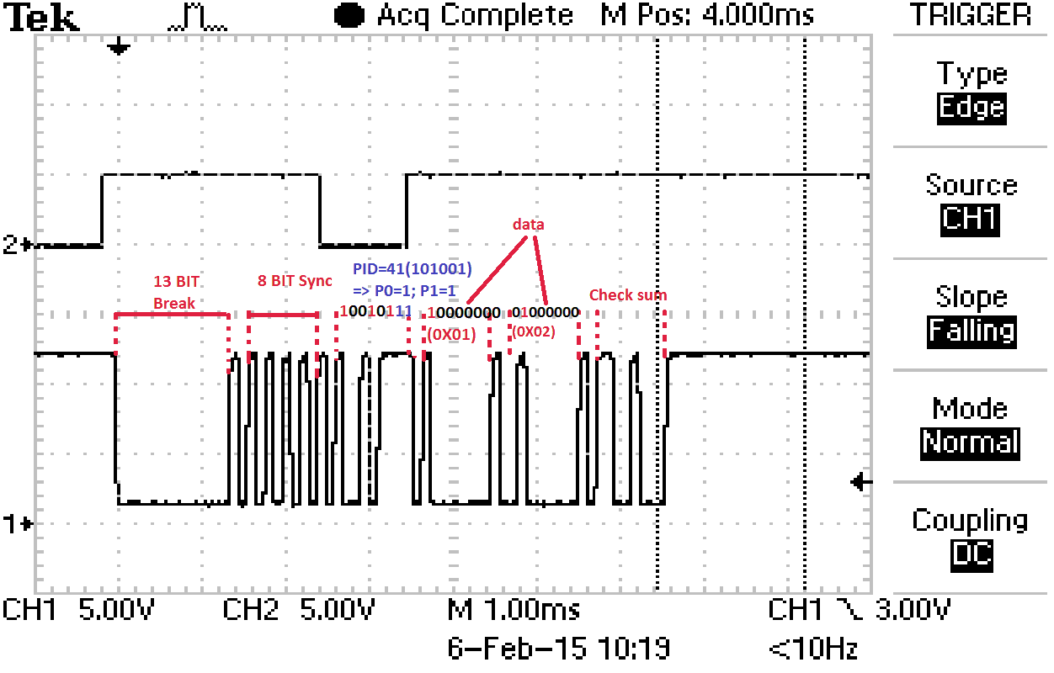
6.2 Analysis of the frame on the measuring device: Oscilloscope
Baudrate: 9600 bps (1bit ~104us)
Break field: 13 bit
PID field: 239 (0xE9)
Data field - 2 bytes: 0x01, 0x02
Checksum byte – Enhanced type: 19 (0x13)
Use capture mode to capture frame
Use cursor to measure time

Slide 67
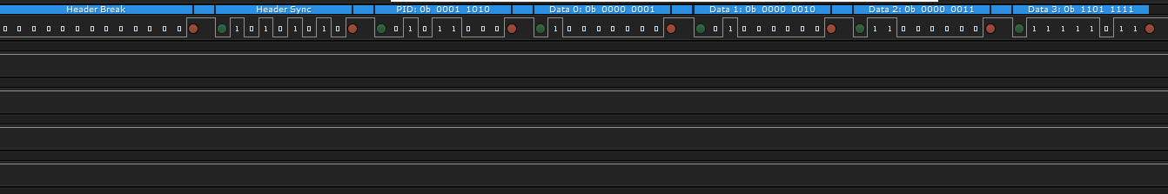
6.2 Analysis of the frame on the measuring device: Analyzer

Slide 68
Purpose& Object
Overview
Introduce of Protocol
Hardware Support for LIN
Introduce of AUTOSAR LIN Driver
Tips& Tricks
Questions

Slide 69
1. The LIN has 1 PID byte:
How many frame types does LIN have?
How many PID values are valid?
Answer: As described in Section 2.1.4, the PID has 64 valid values, of which 2 are 63 and 64 are reserved.

Slide 70
2. Finally, anything else?

Slide 71


